Slide 1
Chapter 2
Linear Time-Invariant Systems

Slide 2
Main topic
Unit impulse response of DT systems and convolution sum
Properties of convolution sum
Unit impulse response of CT systems and convolution integral
Properties of convolution integral
Causality and stability of LTI Systems
Solution of LTI differential/difference equations

Slide 3
2.0 INTRODUCTION
LTI systems possesses the superposition property.
Convolution sum（卷积和）
Convolution integral （卷积积分）
linear constant-coefficient differential or difference equations.（线性常系数微分方程和差分方程）
线性时不变系统的时域分析

Slide 4
2.1 Discrete-Time LTI Systems: Convolution Sum
The Representation of Discrete-time Signals in Terms of Impulses
The Discrete-time Unit Impulse Response of LTI Systems
The Discrete-time Response of LTI Systems to any Input Signal: Convolution Sum

Slide 5
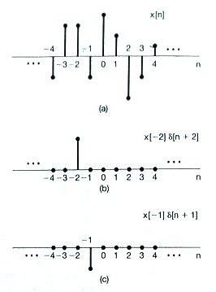
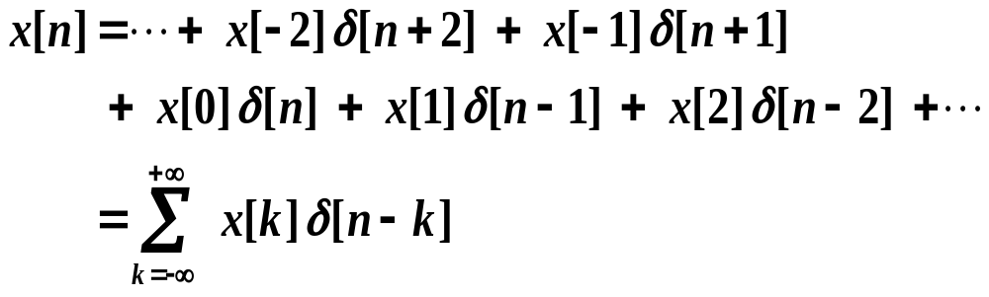
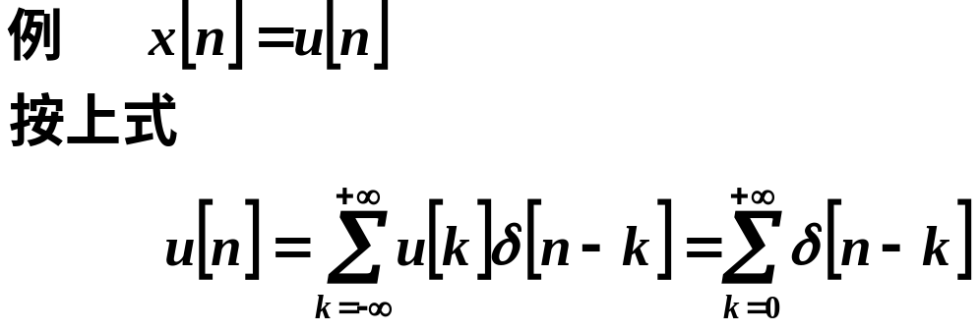
2.1.1 The Representation of Discrete-time Signals in Terms of Impulses
2.1 Discrete-Time LTI Systems: Convolution Sum
Sifting Property of Unit Sample:

Slide 6
2.1.2 The Discrete-time Unit Impulse Response and Convolution Sum of LTI Systems
x[n]=δ [n]
y[n]=h[n]
LTI
Unit Impulse Response h[n] :
Response of the LTI system to the unit sample δ[n].

Slide 7
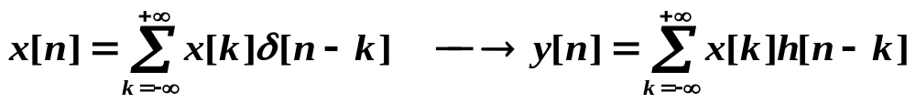
Question:
x[n]
y[n]=?
LTI
δ[n] ⎯→ h[n]
δ[n-k] ⎯→ h[n-k]
x[k]δ[n-k] ⎯→x[k] h[n-k]
Solution:
The response y[n] to x[n] is the
weighted linear combination of delayed unit sample responses.

Slide 8
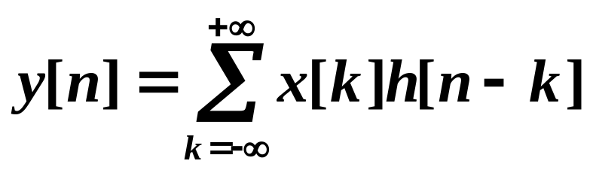
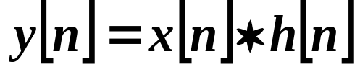
Convolution Sum
——Convolution Sum
x[n]
h[n]
the unit impulse response h[n] can fully characterize a LTI system.

Slide 9
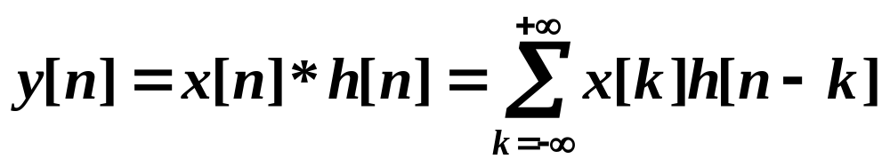
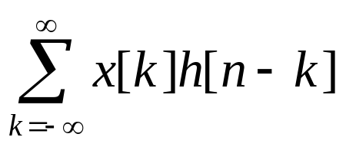
图示法
Graphical interpretation of calculating the convolution sum
Change independent variable: n ⎯→ k
Time Inversal: h[k] ⎯→ h[-k]
Time Shift: h[-k] ⎯→ h[n-k]
Multiplication: x[k]h[n-k]
Summing:

Slide 10
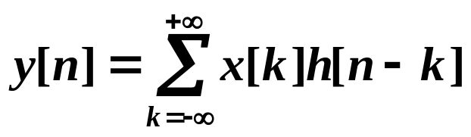
Example 2.1 Consider a LTI system with unit sample response h[n] and input x[n]. Calculate the convolution sum of these two sequences graphically.
x[n]
h[n]
2
2
1
n
n
0 1 2
-2 0 2
(a)
x[k]
h[-k]
2
2
1
k
k
0 1 2
-2 0 2
(b)

Slide 11
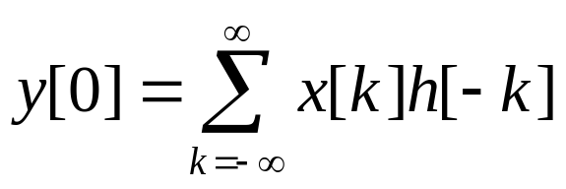
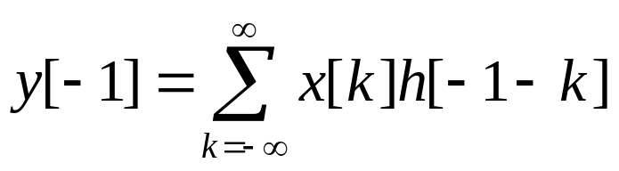

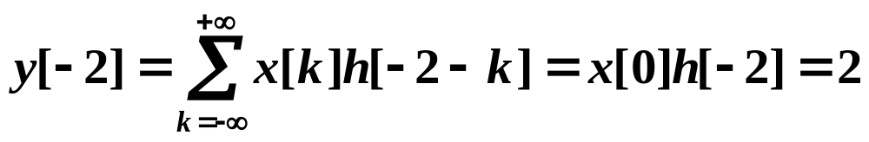
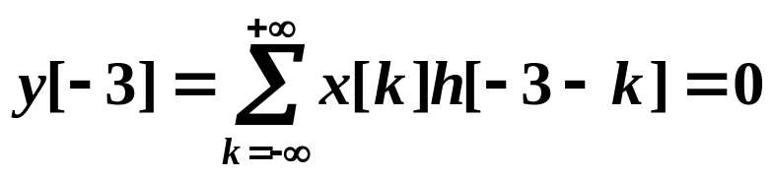
x[k]
2
k
0 1 2
n=0
h[-k]
2
1
k
-2 0 2
h[-1-k]
n=-1
2
1
k
-3 -2 0 1
h[-2-k]
n=-2
2
1
k
-3 -2 0 1

Slide 12
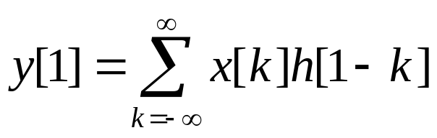
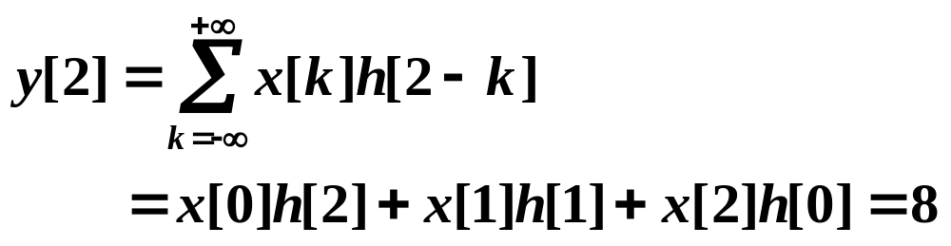
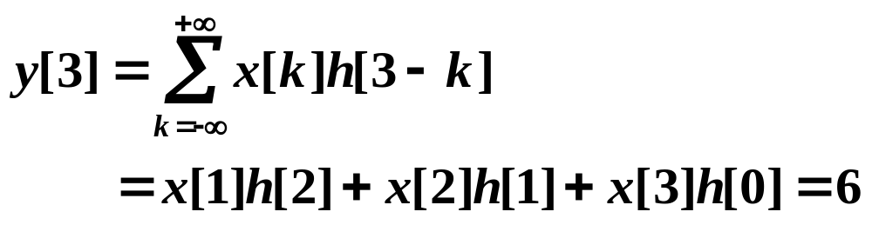
x[k]
2
k
0 1 2
n=1
h[1-k]
2
1
k
-1 0 1 2 3
n=2
h[2-k]
2
1
k
-1 0 1 2 3 4
n=3
h[3-k]
2
1
k
0 1 2 3 4 5

Slide 13
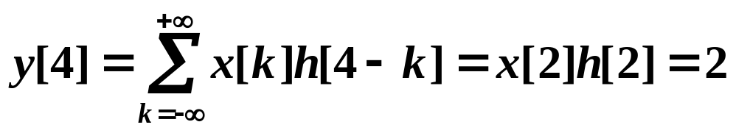
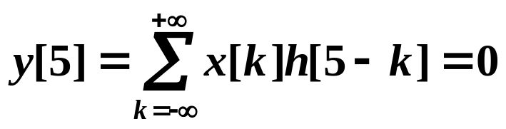
x[k]
2
k
0 1 2
n=4
h[4-k]
2
1
k
0 1 2 3 4 5 6
y[n]
10
8
6
2
n
-3-2-1 0 1 2 3 4 5

Slide 14
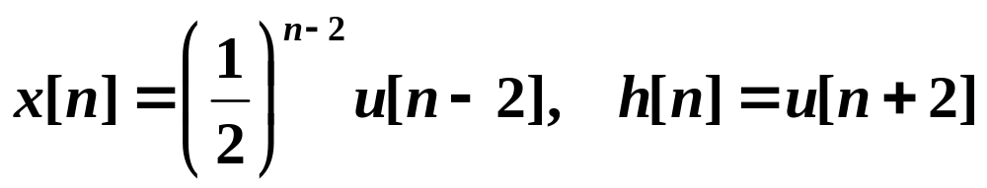

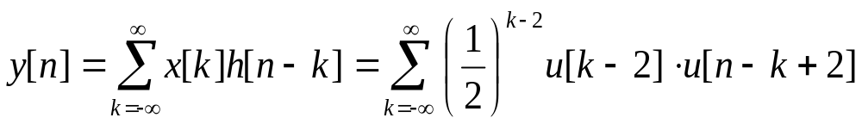
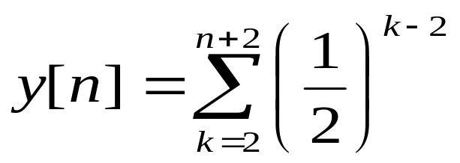

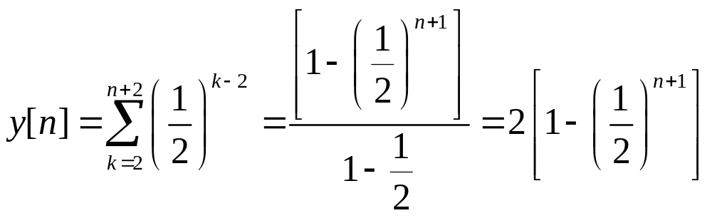
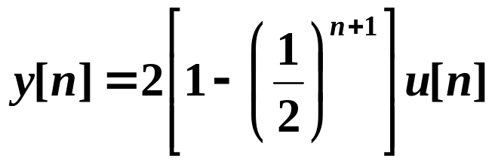
Example 2.2
Determine the output

Slide 15
y[n]
2
1
…
…
n

Slide 16

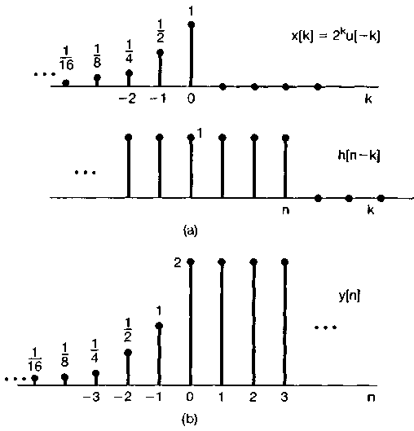
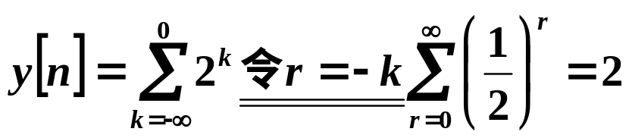
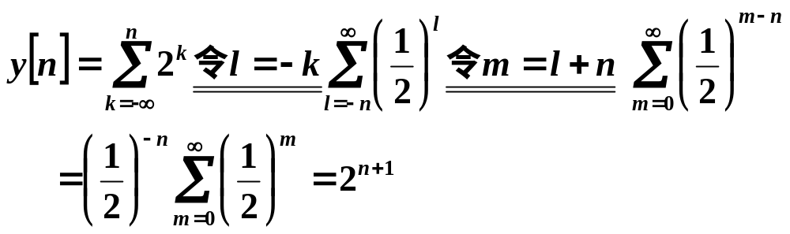
Example 2.3
Determine and plot the output
右移, n>0，有重合
左移, n<0, 部分重合

Slide 17
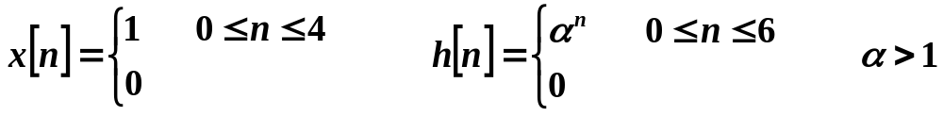
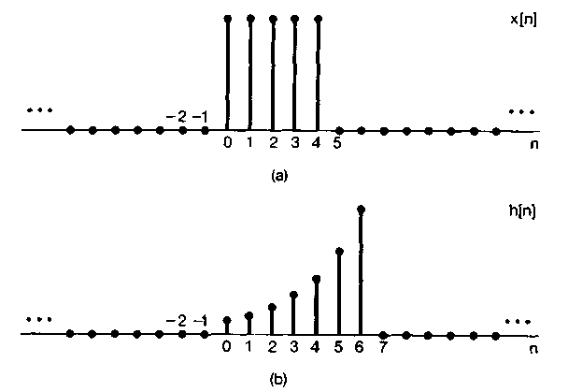
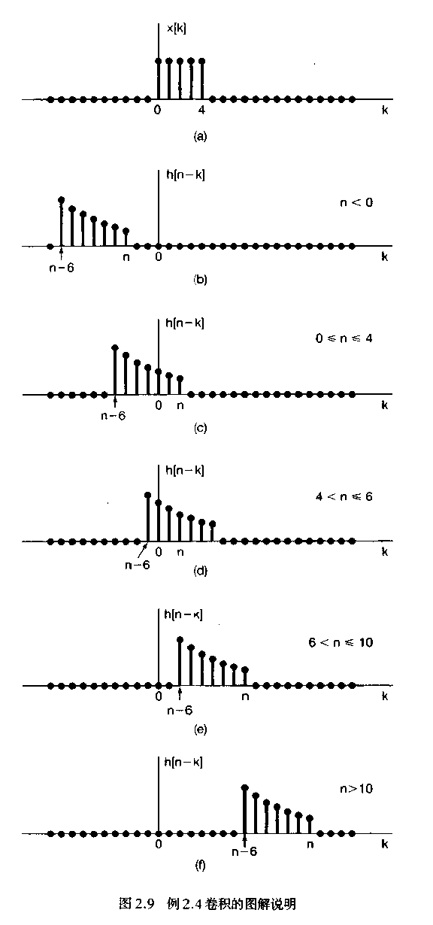

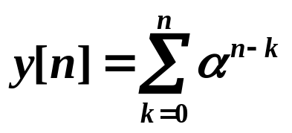

Example 2.4
Determine and plot the output
n<0 向左移,无重合

Slide 18

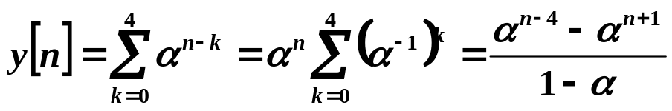

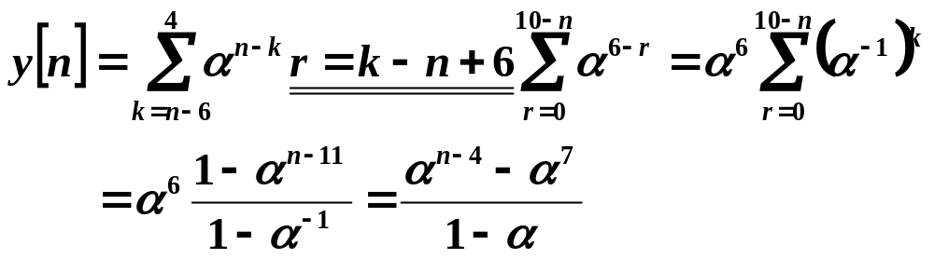
n>10 无重合

Slide 19
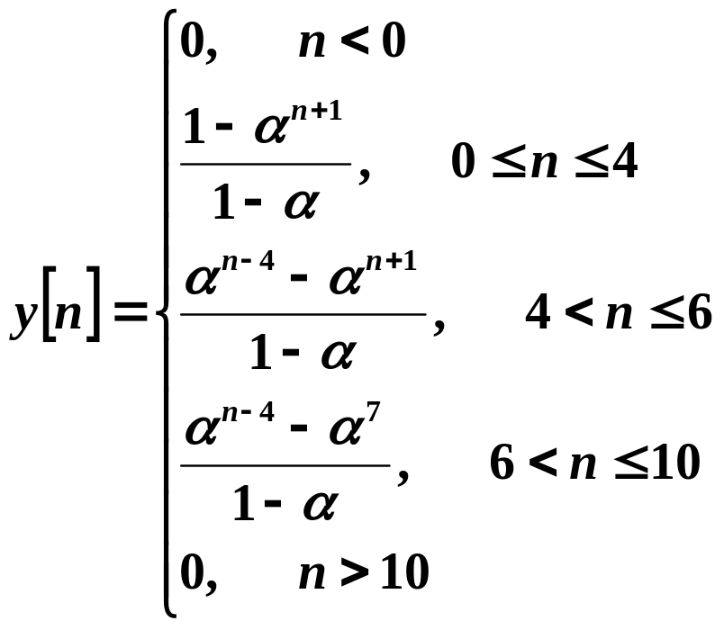
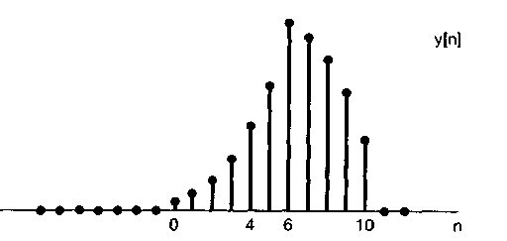

Slide 20
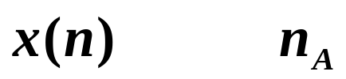
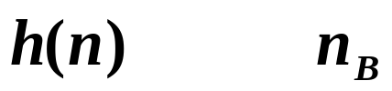
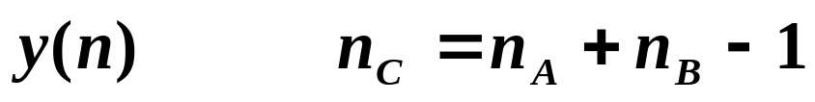
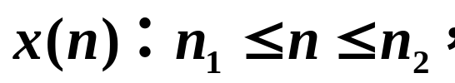
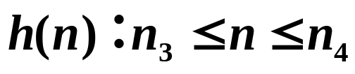
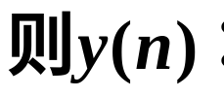
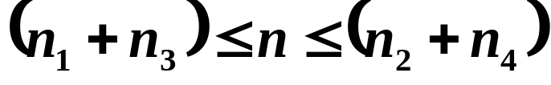
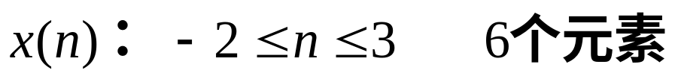
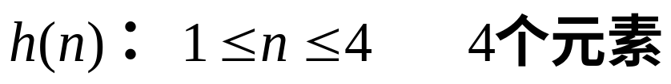
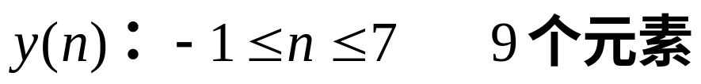
y(n)的元素个数?
若：
例如：

Slide 21
2.2 Continuous-Time LTI: Convolution Integral
The Representation of Continuous-time Signals in Terms of Impulses
The Continuous-time Unit Impulse Response of LTI Systems
The Continuous-time Response of LTI Systems to any Input Signal: Convolution Integral

Slide 22
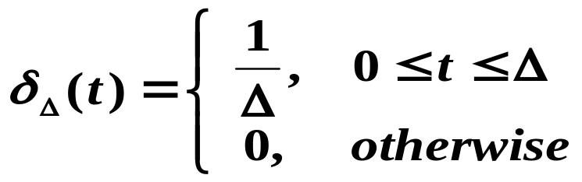
2.2.1 The Representation of Continuous-time Signals in Terms of Impulses
x(t)
┉
┉
┉
-Δ0Δ2Δ kΔ
t
Staircase approximation to a continuous-time signal x(t)
δ_{Δ}(t)
Define
1/Δ
t
Δ

Slide 23


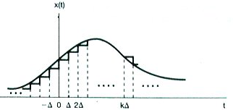


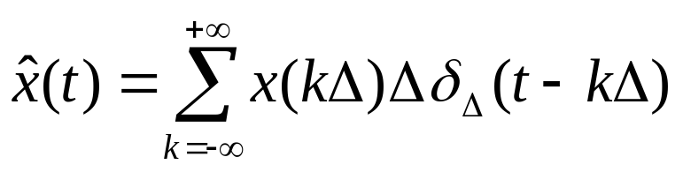
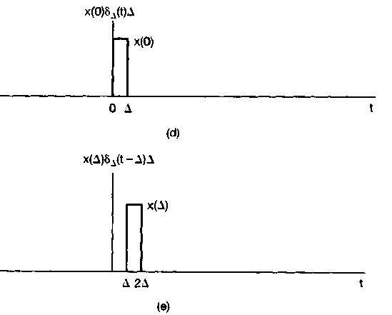



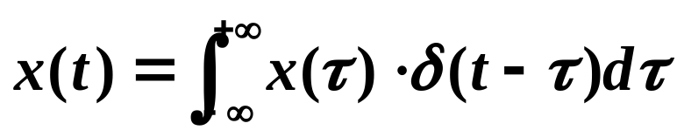

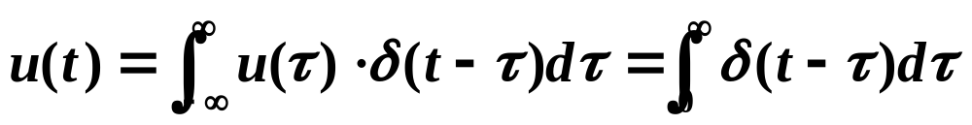
As
sum ⎯→integral

Slide 24

2.2.2 The Continuous-time Unit Impulse Response and Convolution Integral of LTI Systems
x(t)=δ(t)
y(t)=h(t)
LTI
Unit Impulse Response h(t) :
The response of the LTI system to the input
Question:
x(t)
y(t)=?
LTI

Slide 25










x(t)
y(t)=?
LTI
As
—— Convolution Integral

Slide 26

Convolution Integral
x(t)
h(t)
A continuous-time LTI system is completely characterized by its unit impulse response h(t) .

Slide 27

图示法
Graphical interpretation of calculating the convolution Integral
Change independent variable: t ⎯→ τ
Time Inversal: h(τ ) ⎯→ h(-τ )
Time Shift: h(-τ ) ⎯→ h(t -τ )
Multiplication: x(τ )h(t -τ)
Integral :

Slide 28










Example 2.6

Slide 29





t ：移动的距离
t =0 f₂(-τ) 未移动
t >0 f₂(t-τ) shift right
t <0 f₂(t-τ) shift left

Slide 30




t ≤-1
两波形没有公共处，二者乘积为0，即积分为0

Slide 31







-1≤ t ≤1
时两波形有公共部分，积分开始不为0，
积分下限-1，上限t ，t 为移动时间;

Slide 32



1≤ t ≤2
即1 ≤ t ≤ 2

Slide 33



2 ≤ t ≤ 4
即2 ≤ t ≤ 4

Slide 34


t ≥ 4
t-3≥1
即t ≥ 4

Slide 35





Slide 36

Example 2.7
2 x(t) 1 h(t)
0 1 2 t
0 1 2 3 t -1
x(τ)
h(-τ)
-2 0 1 2 3 τ
t=0
x(τ)
h(t-τ)
-2 0 1 2 3 τ
t
t<1
When t<1 : x(τ)h(t-τ) = 0
So

Slide 37



x(τ)
h(t-τ)
-2 0 1 t 2 3 τ
1<t<2
x(τ)
h(t-τ)
-2 0 1 2 t 3 τ
2<t<3
x(τ)
h(t-τ)
-2 0 1 2 3 t 4 τ
3<t<4

Slide 38

x(τ)
h(t-τ)
-2 0 1 2 3 4 t 5 τ
4<t<5
x(τ)
h(t-τ)
-2 0 1 2 3 4 5 t τ
t ≥ 5
When t≥5 : x(τ)h(t-τ) = 0
So
y(t)
0 1 3 5 t
-2

Slide 39











卷积结果区间的确定
上限
下限
一般规律：
[A,B]
0
2
+
[C,D]
[A+C,B+D]

Slide 40






Example 2.8
h(τ)=u(τ-3)
τ
3
h(-τ)=u(-τ-3)
τ
-3

Slide 41
2.3 Properties of LTI Systems
The Commutative Property （交换律）(Ch. 2.3.1)
The Distributive Property （分配律）(Ch.2.3.2)
The Associative Property （结合律）(Ch.2.3.3)
LTI System with and without Memory(Ch.2.3.4)
Invertibility of LTI system （可逆性）(Ch.2.3.5)
Causality for LTI system （因果性）(Ch.2.3.6)
Stability for LTI system （稳定性）(Ch.2.3.7)
The Unit Step Response of LTI system (Ch.2.3.8)

Slide 42


h(t) or h[n] completely characterizes an LTI system
x(t)
h(t)
x[n]
h[n]

Slide 43
2.3.1 The Commutative Property （交换律）
x(t)
y(t)=x(t)*h(t)
x[n]*h[n]=h[n]*x[n]
x(t)*h(t)=h(t)*x(t)
h(t)
h(t)
y(t)=h(t)*x(t)
x(t)
卷积结果与交换两函数的次序无关。

Slide 44
2.3.2 The Distributive Property （分配律）
x[n]*{h₁[n]+h₂[n]}=x[n]*h₁[n]+x[n]*h₂[n]
x(t)*{h₁(t)+h₂(t)}=x(t)*h₁(t)+x(t)*h₂(t)
h₁(t)
y(t)=x(t)*h₁(t)+x(t)*h₂(t)
x(t)
⊕
h₂(t)
x(t)
y(t)=x(t)*{h₁(t)+h₂(t)}
h₁(t)+h₂(t)
子系统并联时，总系统的冲激响应等于各子系统冲激响应之和。

Slide 45
2.3.3 The Associative Property （结合律）
x[n]*{h₁[n]*h₂[n]}={x[n]*h₁[n]}*h₂[n]
x(t)*{h₁(t)*h₂(t)}={x(t)*h₁(t)}*h₂(t)
y(t)=x(t)*h₁(t)*h₂(t)
x(t)
h₁(t)
h₂(t)
y(t)=x(t)*h₂(t)*h₁(t)
x(t)
h₂(t)
h₁(t)
x(t)
y(t)=x(t)*{h₁(t)*h₂(t)}
h₁(t)*h₂(t)
子系统级联时，总的冲激响应等于子系统冲激响应的卷积。

Slide 46



与冲激函数的卷积

Slide 47
2.3.4 LTI System with and without Memory
Memoryless system:
Discrete time: y[n]=kx[n], h[n]=?
Continuous time: y(t)=kx(t), h(t)=?
系统的响应只和当前时刻的激励有关。
δ (t)
h(t)= kδ(t)
h(t)
δ [n]
h[n]=kδ[n]
h[n]

Slide 48
2.3.5 Invertibility of LTI system(可逆性)
Reverse system
y(t)
h₂(t)
x(t)
h₁(t)
x(t)
h(t) ＝δ(t)
（恒等系统）
x(t)
x(t) =x(t)*δ(t)
h₁(t)*h₂(t)=δ(t) or h₁[n]*h₂[n]=δ[n]
Example 2.11
Reverse system
x(t)
h₁(t) =δ(t-t₀)
h₂(t) =δ(t+t₀)
x(t)
y(t)= x(t-t₀)
h(t) =h₁(t)* h₂(t) =δ(t-t₀)* δ(t+t₀) = δ(t)

Slide 49






2.3.6 Causality for LTI system （因果性）
Discrete time system : h[n]=0 for n<0
Continuous time system: h(t)=0 for t<0
因果系统的输出信号（响应）不会出现在输入信号之前。
输出不超前于输入。
LTI系统是的因果系统
其冲激响应是一个因果信号
Example
causal
not causal

Slide 50







2.3.7 Stability for LTI system （稳定性）
Bounded input produces bounded output.
Discrete time system:
If |x[n]|<B，
LTI system is stable
Continuous time system:
Example 2.13
stable
not stable

Slide 51
2.3.8 The Unit Step Response of LTI system
The unit step response s[n] or s(t)
δ[n]
h[n]
h[n]
u[n]
s[n]=u[n]*h[n]
δ(t)
h(t)
h(t)
u(t)
s(t)=u(t)*h(t)

Slide 52




δ[n]
h[n]
h[n]
u[n]
s[n]=u[n]*h[n]
sum
difference

Slide 53




δ(t)
h(t)
h(t)
u(t)
s(t)=u(t)*h(t)
integral
derivative

Slide 54
2.4 Causal LTI Systems described by Differential and Difference Equations
Continuous-time system: Differential Equation （微分方程）(Ch.2.4.1)
Discrete-time system: Difference Equation （差分方程）(Ch.2.4.2)
Block Diagram Representations (Ch.2.4.3)

Slide 55





2.4.1 Linear Constant-Coefficient Differential Equations
R
: input signal
v_{s}
i (t)
C
+
–
: output signal

Slide 56




A general Nth-order linear constant-coefficient
differential equation
How to find the system output given an input signal?
homogeneous solution（齐次解）
natural response （自由响应）
particular solution （特解）
forced response（强迫响应）

Slide 57




Classical Method
Homogeneous solution：微分方程右端=0的解。
Charactristic equation
N eigenvalues
不同特征根对应的齐次解形式：
single roots：
r-th order multiple roots：

Slide 58













Particular solution：与激励有关。
代入原方程，比较系数定出特解。
激励函数x(t)
响应函数y(t)的特解

Slide 59


经典法
全解：齐次解+特解
由初始条件定出齐次解系数A_{k}
一般将激励信号加入的时刻定义为t=0 ，响应为 时的方程的解
初始条件
( N values )

Slide 60










Example
(1) homogeneous solution
特征方程
特征根
齐次解
(2) particular solution
substitute into the differential equation

Slide 61





(3)全解
带入初始条件
natural response
forced response

Slide 62
full response:
Natural+forced
(自由响应＋强迫响应)
Transient+Steady-state
(暂态响应+稳态响应)
Zero-input+Zero-state
(零输入响应＋零状态响应)

Slide 63
(1) Free response：也称固有响应，由系统本身特性决定，与外加激励形式无关。对应于齐次解。
Forced response：形式取决于外加激励。对应于特解。
(2) Transient response ：完全响应中暂时出现的成分，随着时间t增加将消失。
Steady-state response ：完全响应中减去暂态响应分量即得稳态响应分量。

Slide 64


(3) Zero-input response ：
外加激励信号为零，只由初始状态（初始时刻t=0时系统储能）所产生的响应。
Zero-state response ：
起始状态等于零，由系统的外加激励信号产生的响应。
Zero-state linear：当初始状态为零时，系统的零状态响应对于各激励信号呈线性。
Zero-input linear ：当激励为零时，系统的零输入响应对于各初始状态呈线性。

Slide 65

Example
解：

Slide 66






解得

Slide 67









Example
已知某LTI系统可以用以下微分方程表示
求系统的零输入响应、零状态响应和全响应。
(1) zero-input response
特征方程
齐次解
将 代入，解得：

Slide 68









(2) zero-state response
初始状态为零
特征方程
齐次解
代入原方程得
特解
将 代入，得：

Slide 69


(3) Full response
Zero-input Zero-state
Natural forced
Transient-state Steady-state

Slide 70






2.4.2 Linear Constant-Coefficient Difference Equations
A general Nth-order linear constant-coefficient
difference equation:
Backward:
Forward:
initial condition:
y[0], y[1], …… , y[(N-1)] ( N values )

Slide 71



Classical method:
N auxiliary conditions:
y[0], y[1], …… , y[(N-1)]
迭代法(recursive method)：

Slide 72

2.4.3 Block Diagram Representations
Discrete-time system Basic elements
Adder（加法器）
Multiplication by a coefficient（标量乘法器）
unit delay（延迟器）

Slide 73


Example
addition
delay
multiplication

Slide 74


Continuous-time system Basic elements
Adder
multiplier
Integrator （积分器）

Slide 75



Example

Slide 76










Example

Slide 77





2.5 Singularity Functions
2.5.1 The unit impulse as an idealized short pulse
δ_{Δ}(t)
1/Δ
t
0 Δ

Slide 78

2.5.2 Defining the unit impulse through convolution
Operational definition （运算定义）
另一种定义
The primary importance of the unit impulse is not what it is at each value of t, but rather what it does under convolution.

Slide 79






2.5.3 Unit doublets （单位冲激偶） and Other Singularity Functions
冲激偶

Slide 80







Properties of unit doublets
①
②
③
④

Slide 81









x(t)
微分器
定义

Slide 82


记
K个微分器级联
For Example：As
The unit doublet has zero area.

Slide 83





x(t)
积分器
x(t)
y(t)
∫
∫
…
∫
k=2

Slide 84




微分n次
积分m次

Slide 85






Example

Slide 86







注意
用微积分性质
✗

Slide 87
SUMMARY
Convolution sum representation for the response of a discrete-time LTI systems;
Convolution integral representation for continuous-time LTI systems;
Relating LTI system properties, including causality, stability, to corresponding properties of the unit impulse (sample) response;
Some of the properties of systems described by linear constant-coefficient differential (difference) equations.

Slide 88
Exercises
2.5
2.8
2.11
2.28(d)
2.29(e)
2.61(b)

